Slide 1
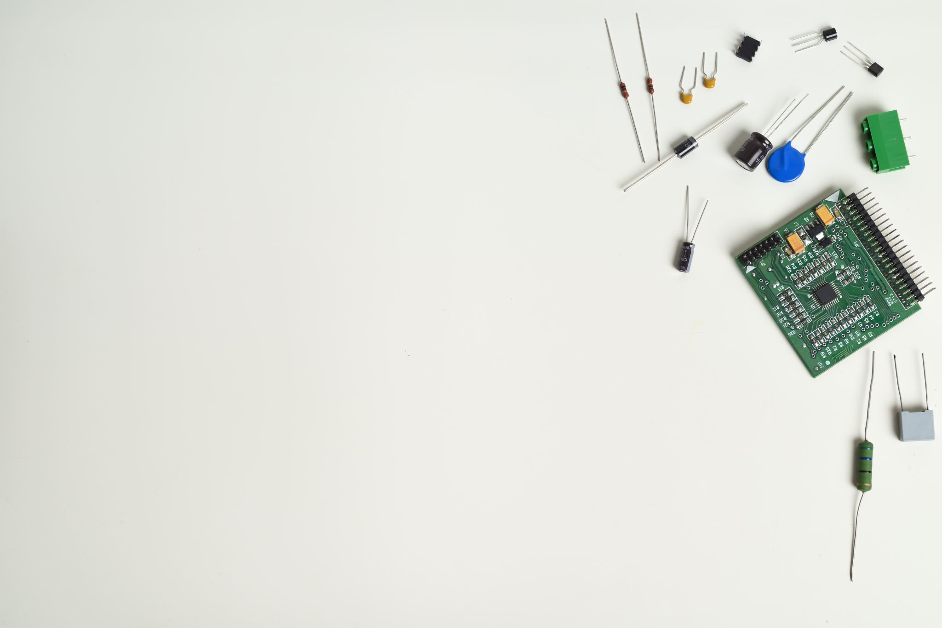
Designing Circuit in Software
Group 4
Varundeep Singh
C0754247

Slide 2
Contents -
Introduction.
Creating a new project on EasyEDA.
Steps to add and connect components.
Interfacing IR sensors with Arduino Uno.
Interfacing LCD with Beaglebone Black.
Interfacing ESP8266 with Beaglebone Black.
Interfacing buzzer, relay and bulb with Beaglebone Black.
Interfacing Bluetooth module with Beaglebone Black.
Interfacing Bluetooth module with Arduino Uno.
Schematic Diagram.
References.

Slide 3
Introduction -
EasyEDA is an easy and powerful online PCB tool that allows to design and share projects.
More than 1 million free libraries are available.
Its online feature allows the option to work anywhere and anytime.
It provides a direct link for components selection.
The schematic diagram can be exported in the form of PNG, PDF and JPEG.
It provides integrated PCB fabrication.

Slide 4
Creating a new project on EasyEDA -
Go to https://easyeda.com/
Login/create an account to use the software. It is free of cost.
Go to your personal workspace and create a new project.
Add schematic diagram page.
Search and add the components from the library.
Draw the connections between the terminals.

Slide 5
Steps to add and connect components -
Search for your components like Beaglebone Black, Arduino Uno, ESP8266, etc. from the ‘Library’ tab.
Search for other components like GND and VCC from the ‘EELib’ tab.
Select your desired component and click on ‘Place’ to add it to your schematic page.
Using your mouse, join the terminals and make connections where needed.

Slide 6
Interfacing IR sensors with Arduino Uno -
VCC of the IR sensors is connected to +5V power supply.
GND pins are connected to the ground.
The OUT pins are connected to the D8 and D9 pins of the Arduino Uno.
These are digital input/output pins.
D9 provides an 8-bit PWM output.

Slide 8
Interfacing LCD with Beaglebone Black -
VCC of the LCD is connected to the power supply.
GND is connected to the ground.
SDA (Serial Data Line) pin is connected to P9.20 (I2C2_SDA) pin of the Beaglebone Black.
SCL (Serial Clock Line) pin is connected to P9.19 (I2C2_SCL) pin of the Beaglebone Black.

Slide 10
Interfacing ESP8266 with Beaglebone Black -
Vin is connected to the power supply.
GND is connected to the ground.
Rx pin of the ESP8266 is connected to P9.24 (UART1_TXD) pin of the Beaglebone Black.
Tx pin of the ESP8266 is connected to P9.26 (UART1_RXD) pin of the Beaglebone Black.

Slide 12
Interfacing buzzer, relay and bulb with Beaglebone Black -
Buzzer –
GND is connected to the ground.
P8.8 (Timer7) pin of the Beaglebone Black is connected to the buzzer.
2. Relay and Bulb –
VCC is connected to +5V power supply.
GND is connected to the ground.
IN is connected to P9.30 (GPIO) pin of the Beaglebone Black.
COM (Common) pin is connected to the power supply.
NO (Normally Open) pin is connected to the bulb.
One end of the bulb is connected to the ground.

Slide 14
Interfacing Bluetooth module with Beaglebone Black -
VCC is connected to +5V power supply.
GND is connected to the ground.
Tx pin is connected to P9.11 (UART4_RXD) pin of the Beaglebone Black.
Rx pin is connected to P9.13 (UART4_TXD) pin of the Beaglebone Black.

Slide 16
Interfacing Bluetooth module with Arduino Uno -
VCC is connected to +5V power supply.
GND is connected to the ground.
Tx pin is connected to D0 (Rx) pin of the Arduino Uno.
Rx pin is connected to D1 (Tx) pin of the Arduino Uno.

Slide 18
Schematic Diagram -

Slide 19
References -
About EasyEDA. (n.d). Retrieved from https://easyeda.com/page/about
Arduino Uno. (2018, February 28). Retrieved from https://components101.com/microcontrollers/arduino-uno
Beaglebone Black. (2018, July 9). Retrieved from https://components101.com/microcontrollers/beaglebone-black-pinout-datasheet
ESP8266 – WiFi Module. (2018, March 20). Retrieved from https://components101.com/wireless/esp8266-pinout-configuration-features-datasheet
Interface One Channel Relay Module with Arduino. (n.d). Retrieved from https://lastminuteengineers.com/one-channel-relay-module-arduino-tutorial/
Joseph, A. (2020, May 5). Interface I2C 16x2 LCD with Arduino Uno (Just 4 wires). Retrieved from https://create.arduino.cc/projecthub/akshayjoseph666/interface-i2c-16x2-lcd-with-arduino-uno-just-4-wires-273b24

